Slide 1
Plant disease detection using machine learning techniques

Slide 2
Team Members
Name: Guna Veerendra J Student ID: 700744362 Name: Dasoju Nikhil Student ID: 700740679 Name: Yaswanth Sompalle Student ID: 700741917 Name:PRAHARSHA CHITTIMALLA Student ID:700747764

Slide 3
Role/Responsibilities and Contribution
Action item | Team member | Description
Requirement Analysis | Nikhil, veerendra | Necessary libraries and IDE tools to implement, required ML Techniques
Project flow design | Yeshwanth | Project flow is designed and delegated the work to each team member
Data collection and cleaning | Praharsha | Data is collected from the GitHub repository and cleaned the data accordingly
Data exploration-EDA | Praharsha, Yeshwanth | Analyzed data on different factors

Slide 4
Motivation
A crucial area of research that has the potential to transform agriculture and increase food security is the detection of plant diseases using machine learning techniques. Plant diseases can have catastrophic consequences on crop output, resulting in food shortages and financial losses, which is what drives our research. Farmers who identify plant illnesses early can take prompt action to stop the disease's progress, reduce crop losses, and boost yields.
Visual inspection is a common method of disease detection, but it can be time-consuming and unreliable, especially for large farms. By examining plant photos and seeing patterns that point to disease, machine learning approaches can assist in automating the disease diagnosis process. Convolutional neural networks and support vector machines, among other machine learning algorithms, can be used to accomplish this.
In conclusion, the development of plant-based disease detection systems using machine learning techniques has the potential to revolutionize the way we monitor and manage plant diseases, leading to more sustainable and secure food production. The motivation for this research stems from the need to address the challenges associated with traditional disease detection methods and to provide accurate and scalable solutions that can benefit farmers and the broader agriculture industry.

Slide 5
Objectives
The objectives of the project include:
Developing machine learning algorithms that can accurately detect plant diseases using images of plant leaves, stems, and other parts. Providing an automated and cost-effective system for the early detection of plant diseases.
Creating a system that can handle large volumes of data and identify complex patterns and variations in plant diseases.
Develop a system that is easy to use and does not require specialized skills or expertise in plant pathology.
Improving food security by reducing crop losses and increasing the efficiency of disease management in agriculture.

Slide 6
Related work
Plant-based disease detection using machine learning techniques is a rapidly growing field of research with significant potential for improving crop yield and food security. Several studies have been conducted in this area, with many focusing on the use of computer vision and machine learning algorithms to identify and classify plant diseases based on visual symptoms.
One recent study used deep learning algorithms to detect diseases in cassava plants, achieving an accuracy of over 90%. The researchers used a dataset of over 5,000 images of cassava. leaves infected with various diseases and trained a convolutional neural network to identify the specific disease present in each image.
The use of hyperspectral imaging and machine learning to detect early signs of grapevine disease. The researchers used a hyperspectral camera to capture images of leaves and trained a support vector machine (SVM) classifier to distinguish between healthy and diseased leaves based on their spectral signatures.

Slide 7
Related work
Plant-based disease detection using machine learning techniques has gained significant attention in recent years. Here are some related works on this topic:
"Identification of plant diseases using machine learning algorithms" by S. B. Gandhi and V. D.
Pande. In this study, the authors propose an approach for identifying plant diseases using machine learning algorithms, including support vector machines (SVM) and decision trees.
"A review on plant disease detection using machine learning techniques" by R. Rajkumar and V.Anand. This paper provides a comprehensive review of the literature on plant disease detection using machine learning techniques, including artificial neural networks (ANN), SVM, and decision trees.
"Plant disease identification using deep learning techniques: a review" by R. Singh, et al. This study reviews the application of deep learning techniques such as convolutional neural networks (CNN) and recurrent neural networks (RNN) for plant disease identification.

Slide 8
Problem Statement
Detect plants effected with disease using a Machine Learning model, Manual detection is time consuming. we develop computational methods which will eventually let the model learn and simplify the process of detecting plant diseases and classify them.

Slide 9
Proposed Solution
We have proposed a machine learning method which goes as the following steps
We take input as an image which undergoes image pre-processing , which helps us to remove any unwanted elements from image.
The pre-processed images are then used to extract features that can be used to distinguish between healthy and diseased plants.
Various machine learning algorithms can be u sed to build the classification model, such as Support Vector Machines (SVMs), Random Forests, Convolutional Neural Networks (CNNs), and Deep Learning models.
The selected machine learning algorithm is then trained on the extracted features using the training data.
Once the model is trained, it is evaluated using a test dataset that is separate from the training dataset.

Slide 10
Results/Simulations
The dataset was preprocessed. Next, the model is trained and undergoes logistic regression, KNN, linear discriminant analysis, decision tree classifiers, random forest classifiers, naive Bayes, and SVC techniques. Experiment analysis led us to conclude that the Random Forest classifier provides higher accuracy than the alternative classification approaches (see fig. Cross-validation comparisons of the algorithms are displayed in [a]).

Slide 11
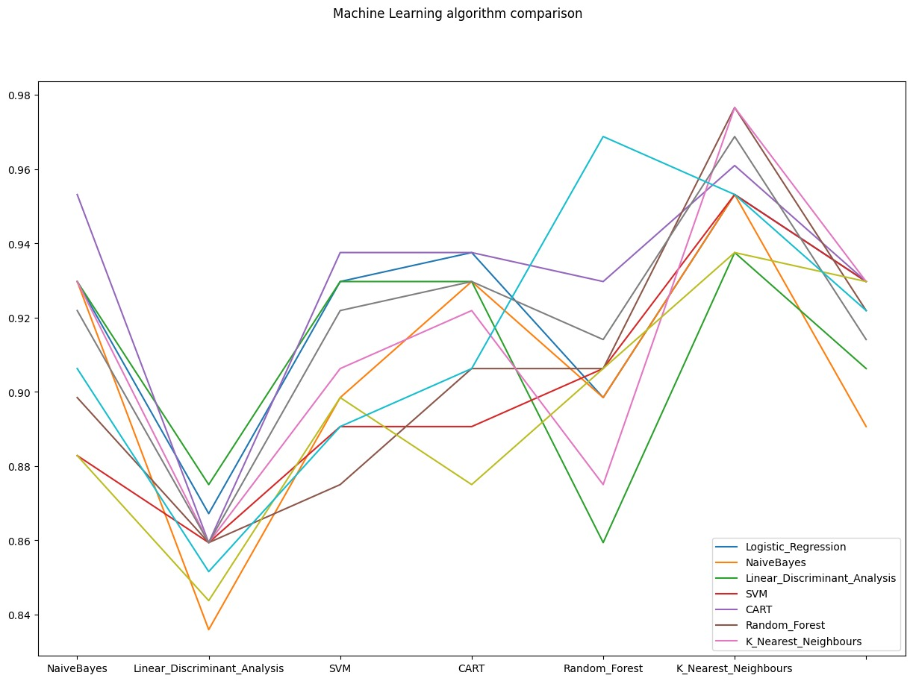
Compare Cross Validation Scores Fig[a]

Slide 12
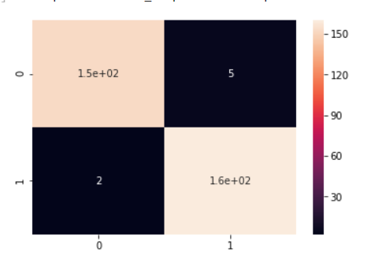
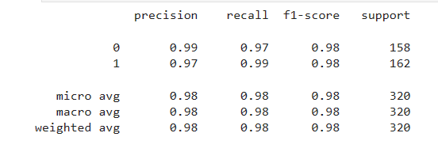
Results
We have built the confusion matrix for the Random Forest algorithm to analyze its efficacy. A confusion matrix is a tabular representation of a classifier's accuracy and error rates. It is a metric for gauging how well a classification model does its job. To measure the efficacy of a machine learning model, we can look at its performance indicators, which can be found in a report called a classification report.

Slide 13
References
S. Singhal, S. Pandey, and A. Srivastava, "Plant disease detection using machine learning techniques: A review," in 2018 4th International Conference on Computing Communication and Automation (ICCCA), Greater Noida, India, 2018, pp. 1-6. doi: 10.1109/CCAA.2018.8484224.
2. S. Gupta, S. K. Singh, and M. K. Tiwari, "Deep learning based plant disease detection using transfer learning with VGG-19 model," in 2019 3rd International Conference on Computing Methodologies and Communication (ICCMC), Erode, India, 2019, pp. 32-36. doi: 10.1109/ICCMC.2019.8868811.
M. J. Valero, M. A. Hervás, J. M. García-Chamizo, and M. J. Castro-García, "A comprehensive survey of deep learning for plant disease detection," Computers and Electronics in Agriculture, vol. 163, p. 104859, 2019. doi: 10.1016/j.compag.2019.104859.
A. N. Shrivastava and S. S. Sahoo, "Plant disease detection using image processing and convolutional neural network," in 2018 3rd International Conference on Computing, Communication and Security (ICCCS), Haryana, India, 2018, pp. 1-5. doi: 10.1109/CCCS.2018.8693226.
B. Das and R. K. Kalita, "Plant disease identification using kmeans clustering and support vector machine," in 2018 International Conference on Smart Technologies for Smart Nation (SmartTechCon), Bangalore, India, 2018, pp. 852-856. doi: 10.1109/SmartTechCon.2018.8761663. A Review on Machine Learning Classification Techniques for Plant Disease Detection. DOI: 10.1109/ICACCS.2019.8728415 9.
Rice Leaf Disease Detection Using Machine Learning Techniques. Kawcher Ahmed; Tasmia Rahman Shahidi; Syed Md. Irfanul Alam; Sifat Momen .DOI: 10.1109/STI47673.2019.906809

